Slide 1
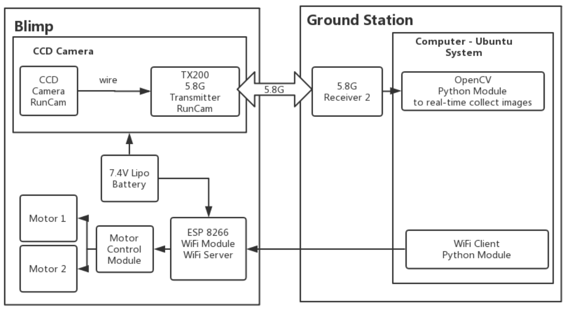
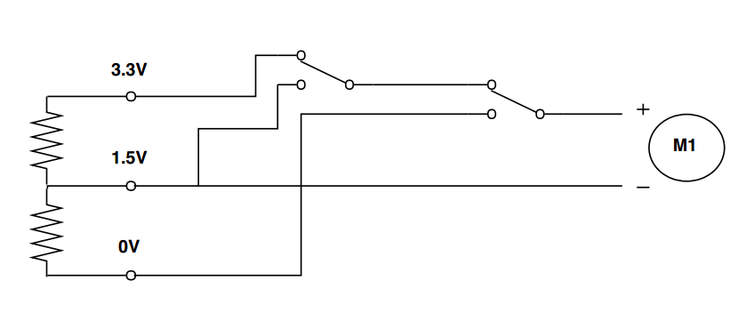
Hardware
Future Work
Motor Control Module
Weight
Power
WiFi

Slide 2
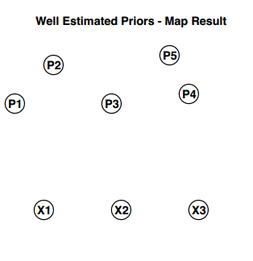
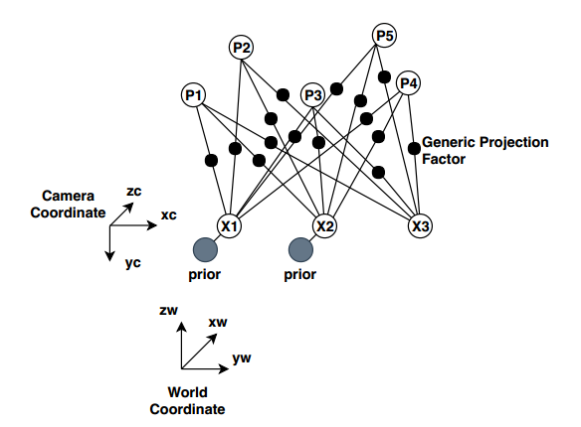
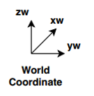
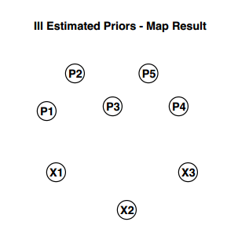
Mapping: Stucture form Motion (SfM)
Input:
Features of corresponding Landmark Points (Pn) in images capture by camera at different poses (Xn).
Output:
Landmark Points and Camera Poses in the world coordinate.

Slide 3

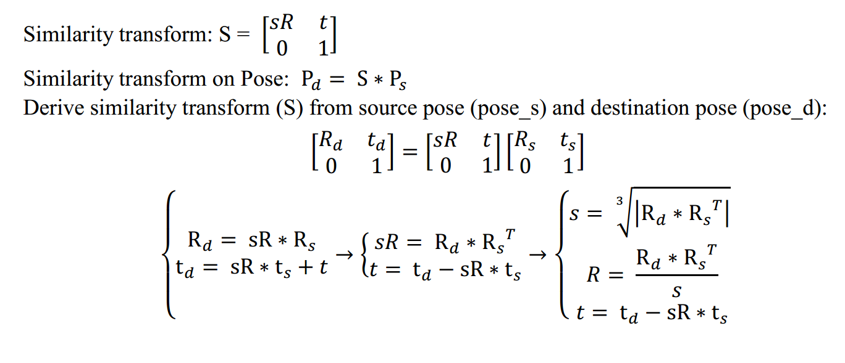
Similarity
Transform:

Slide 4
Localization: If a map is available a-priori then the problem becomes pose-estimation

